Slide 1
New Trends in Marketing Research

Slide 2
CHAPTER GOALS
Learn about marketing research: different types and current trends
Learn a Listening Strategy: Recognize lecture language that introduces the topic and lecture plan
Learn a Note-taking Strategy: Organize your notes by outlining
Learn a Discussion Strategy: Express your ideas during a discussion

Slide 3
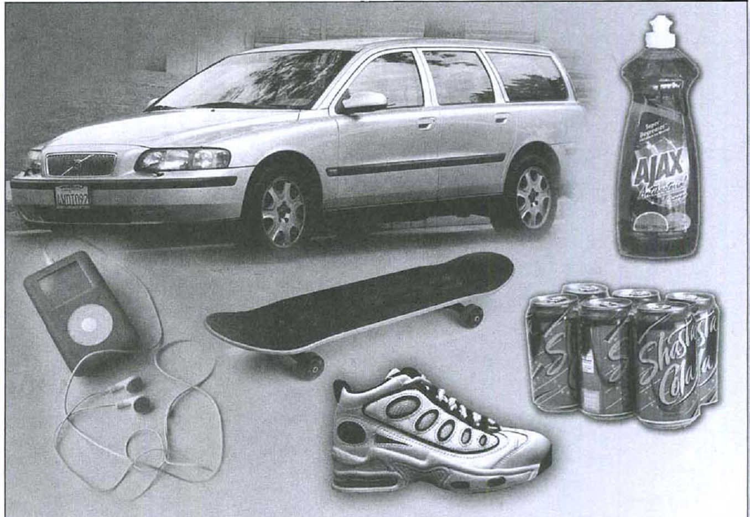
Build Background Knowledge
1. Look at these products. Then answer the questions below in pairs

Slide 4
1. Look at the list of factors to consider when purchasing a product. Which factors are most important when purchasing the items in the picture?
cost
health or safety
how well it works
how it looks, tastes, or smells
the brand (company name)
how it makes you feel
3

Slide 5
2. Imagine this situation. You are president of a chocolate company. Sales of your most popular chocolate bar have decreased sharply this year. You want to find out what people think about your company and this product. What are some ways you can do this?
Have surveys or questionaires

Slide 6
2. Read this chapter from a marketing textbook on focus groups and how they are used in marketing research
Talking to Your Target Market: Focus Groups
For years, marketing experts have used various methods to try to understand why consumers chose to buy certain products. How do shoppers differentiate one product from another? What motivates a consumer to choose one brand over another? Marketing researchers want to understand the decision making processes of consumers. That information can help companies decide how to advertise a product or service; it can also help them design new products or redesign existing products so that they will sell better

Slide 7
In this chapter we will look at the focus group, a type of group interview. It has become one of the main marketing research tools to find out how people in the target market feel about themselves and the particular brand, product, or service being researched

Slide 8
For a focus group, researchers usually find six to twelve volunteers from their target market and bring them together for one or two hours to answer questions and talk about a product, service, or brand. A skilled discussion leader encourages free discussion but focuses the conversation on the product being researched. To do this, discussion leaders ask a lot of open-ended questions, not simple yes/no or limited choice questions. Open-ended questions allow the group's participants to answer in their own words and in ways the discussion leader may not expect.

Slide 9
Focus groups usually start with general questions about product type. For example, a focus group for the high school market could be asked, "Which brands of athletic shoes are the most popular with people at your school? Why?' Later they may be asked more specific questions about a particular brand. Discussion leaders may ask for opinions directly with questions like, "Why do you buy Nike shoes?' Or they may try to get at attitudes and beliefs more indirectly with a question like, "What do you think about people who wear Nike shoes?" The focus group's answers to these questions tell researchers a lot about a brand's image—the way people think about a brand and the people who use the brand. If a lot of kids in a school wear one brand of athletic shoe, this suggests that the brand's image is youthful and popular

Slide 10
Focus groups allow researchers to talk directly with their target market to find out about their beliefs, attitudes, and feelings; however, there are some difficulties in trying to find out what motivates buying behavior with this method. Participants may not always tell the truth. They may avoid disagreeing with others in the group to appear more friendly and likable. They may also lie to avoid embarrassment

Slide 11
Another reason the results may be unreliable is that people are not always aware of what motivates their buying behavior. Some factors are completely unconscious. In fact, a growing body of psychological research suggests that most people will give rational reasons for their purchases when asked, but unconscious emotional needs also influence many of their buying decisions

Slide 12
3. Answer the questions about the reading on page 3. Then discuss your answers with a partner
Why do marketing experts want to learn about how people make buying decisions?
What is an "open-ended" question? Why do focus group discussion leaders ask this type of question?
Why are the opinions given in a focus group sometimes not helpful to marketers?
10

Slide 13
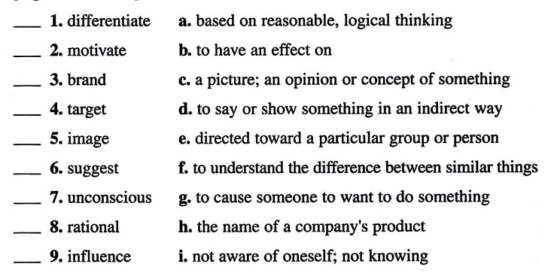
Match the words with their definitions. Look back at the reading on page 3 to check your answers

Slide 14
Prepare to Listen and Take Notes
To help you understand the listening strategy, discuss the situation below and answer the questions
If you arrive late to class and miss the beginning of the lecture, what information might you miss? Why is this information important?

Slide 15
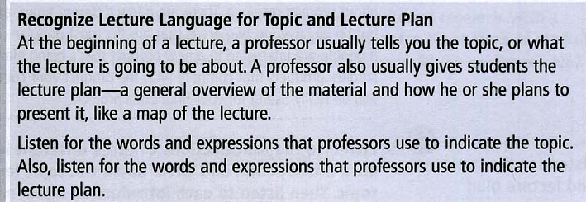
Listening Strategy

Slide 16
Topic lecture language
2. Read the expressions that signal the topic of a lecture. Can you add others to the list?
Today we're going to talk about...
What I want to discuss today is ...
Today's topic is . . .
We'll be looking at...
I'll give you an overview of. ..
Last time we discussed .. ., and this week we're going to ...
In today's class we'll focus on .. .

Slide 17
Lecture plan language
3. Read the expressions that signal the plan of a lecture. Can you add others to the list?
There are a few things we'll be covering today.. ..
We'll start out with .. ., and then look at.. .
I'll be covering two areas in today's lecture....
First, we'll look at..., then ..., and finally we'll move on to . .

Slide 18
Recognize lecture language
4. Read this lecture introduction. Circle the topic. Then underline and label the lecture language that signals the topic and the lecture language that signals the lecture plan

Slide 19
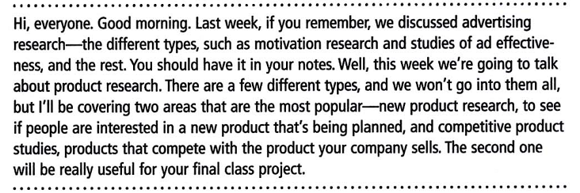

Slide 20
Listen for the topic and lecture plan
5. Listen to the introductions of three different lectures. First listen to each introduction and write down the topic lecture language and the topic. Then listen to each introduction again and write down the lecture language that signals a plan, and also the plan

Slide 21
1. Topic lecture language: ________________________
Topic: _____________________________
Plan lecture language: ___________________________
Plan: _____________________________________________________________________________________________

Slide 22
2. Topic lecture language: ________________
________________
Topic: ________________________________
Plan lecture language: _____________________
_____________
Plan: __________________________ ____________
__________________________

Slide 23
3. Topic lecture language: _________________
____________
Topic: _________________
Plan lecture language: ______________________
__________________________________
Plan: ______________________________________

Slide 24
Note-taking Strategy
Organize Your Notes by Outlining
a way to visually represent the relationships between ideas
Space and indentation show which ideas are main points and which are supporting points
differentiate main points from supporting points

Slide 25
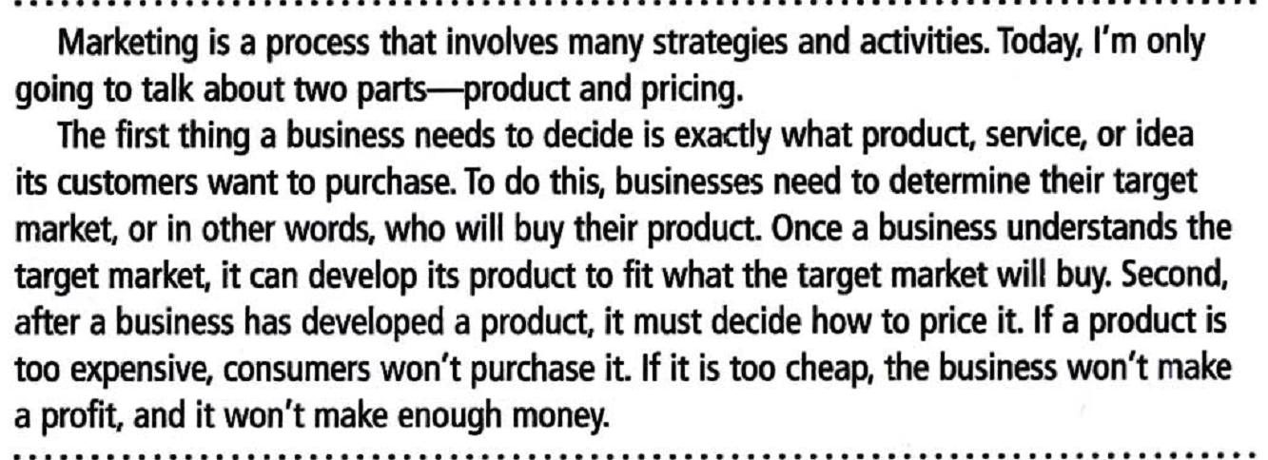
7. Read this lecture transcript and take notes in outline form in your notebook

Slide 26
Marketing strategies & activities
Two parts
Product
Choose product, service, or idea
Determine target market
Pricing
Low enough to sell
High enough to make a profit

Slide 27
Listen and Take Notes
Listening Strategy
Predict
make a prediction about what the professor will discuss based on what you already know about the topic
Make predictions
1. Before the lecture, think about everything you have learned and discussed on the topic of marketing research. What do you expect to learn more about in the lecture? Write three predictions below. Compare your predictions with a partner

Slide 28

Follow the lecture
Now follow the lecture and take notes. Be sure to listen for the lecture language that signals the topic and lecture plan

Slide 29
Assess your comprehension
3. How well were you able to recognize the lecture language? Check the statement that best describes you. Explain your answer.
I was able to recognize when the lecturer said the topic and plan of
the lecture.
I didn't recognize when the lecturer said the topic and plan of the
lecture

Slide 30
4. Use your notes to answer these questions
1. How is neuromarketing research different from other marketing research?
2. Why do researchers care about which area of the brain is used when looking at an advertisement or looking at a product?
3. In the study about cola taste tests, what were the results of the blind taste test? How did the results change when the brand names were given?

Slide 31
4. Why are some people concerned about the use of neuromarketing research?
Note-taking Strategy
Assess Your Notes
Compare notes with classmates in a study group after the lecture to check that your notes are complete
5. Were you able to answer the questions in Exercise 4 using the information in your notes? Compare your notes with a few other students. Discuss the differences and help each other fill in any missing information—words, definitions, ideas. Complete your notes

Slide 32
Discuss the Issues
Express Your Ideas
Many professors in the U.S. will ask students questions during their lectures or in class discussions. Also, students are often expected to express their ideas and opinions with a partner or in small groups
Active participation in class shows that you are interested in and actively thinking about the course content. It can also help you learn and remember the new information presented in class

Slide 33
Read the expressions for expressing your ideas. Can you add others to the list?
I think/believe/feel. . .
In my opinion,. .
Here's what I think . .
I'd like to say/add/mention . . .
Here are my two cents .
What I'd like to say is .
Personally. I think/feel .

